Slide 1

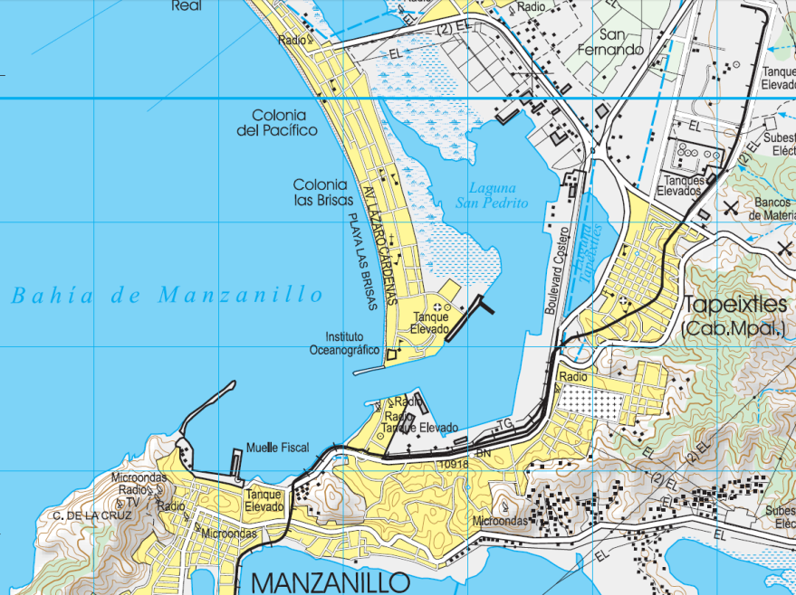
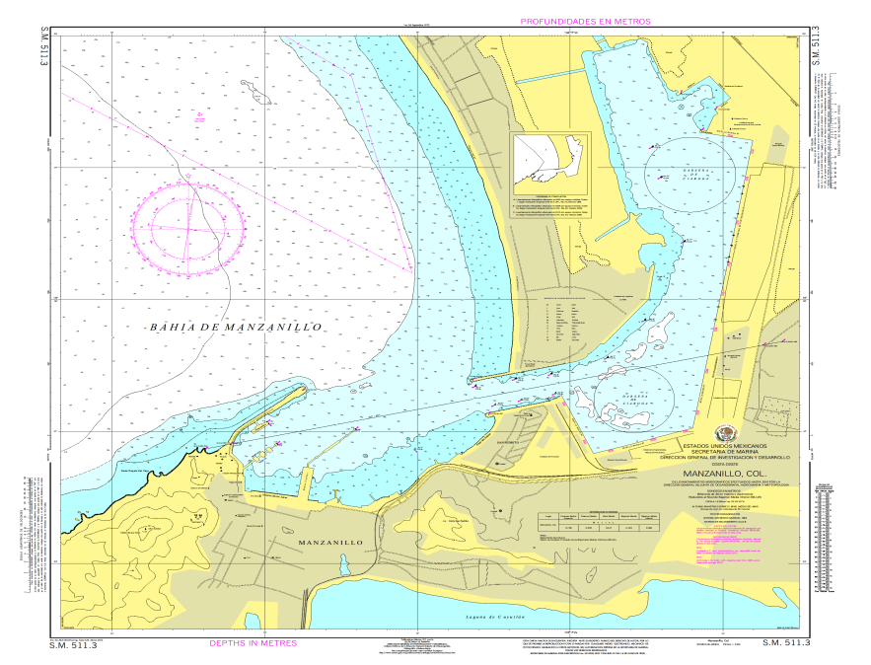
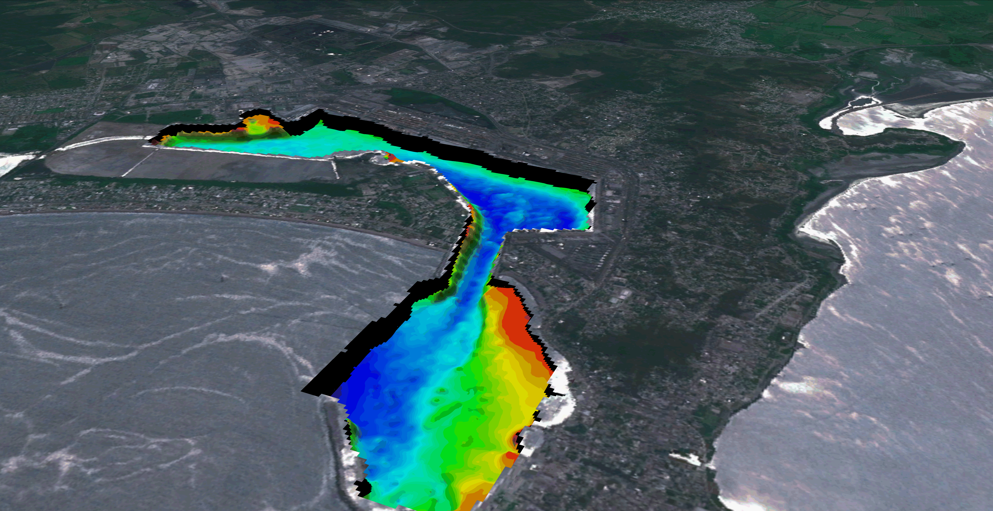
ARMONIZATION OF
MARITIME AND TERRESTRIAL VECTOR DATA

Slide 2

generate
GGIM
SOLUTION SUGGESTED
?
IHO
SOLUTION
MEAN SEA LEVEL
generate
Reference
$$≠$$
DATUM VERTICAL
MLLW
Use
CONTINENTAL
CARTOGRAPHY AUTHORITY
Reference
DVERTICAL
ATUM
ESTADISTICS
Use
Juntos conforman
MARITIME – LAND VECTOR DATA HARMONIZATION
NAUTICAL
CARTOGRAPHY AUTHORITY
GGIM REGIONAL
GLOBAL EXPERTS COMMITTE
UN-GGIM
Instruye
Provides
ACADEMICS
Coordination
NATIONAL / REGIONAL
EFFORTS
GGIM AMERICAS
NATIONAL
SOLUTION
Provides
Standar
Integration
Provides
INDUSTRY

